Slide 1
Clustering in Time Series
Presenter: Xinyue Lu, Yiling Xiong, Waning Jin

Slide 2
Introduction

Slide 3
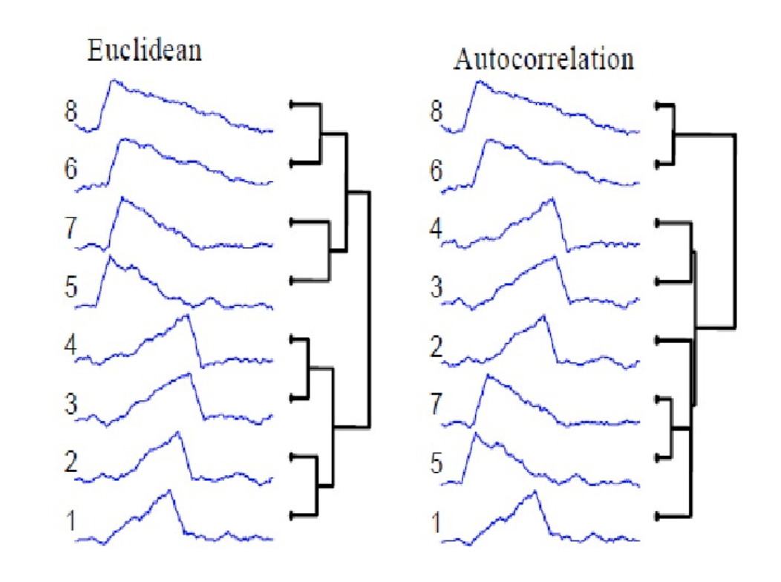
What is Cluster Analysis in Time Series?
Cluster Analysis is a main task of exploratory data mining. It’s a task of grouping a set of objects in such a way that objects in the same group (called a cluster) are more similar to each other than to those in other groups/cluster.
Time series clustering is to partition time series data into clusters based on similarity or distance, so that time series in the same cluster are similar.
There is no specific definition of a cluster. We can perform different clustering algorithms based on different characteristics of the objects and different goals.
*Different cluster methods returns different results

Slide 4
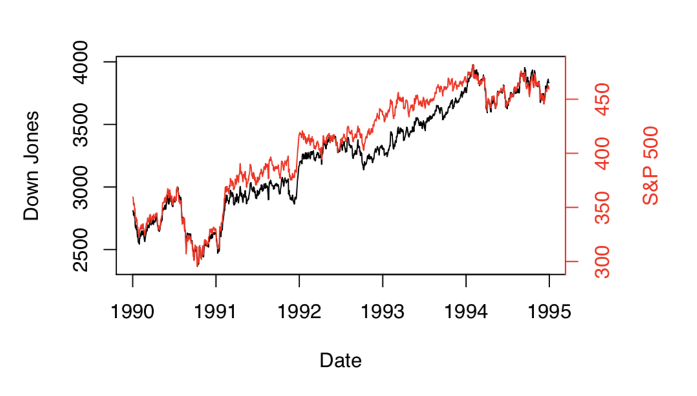
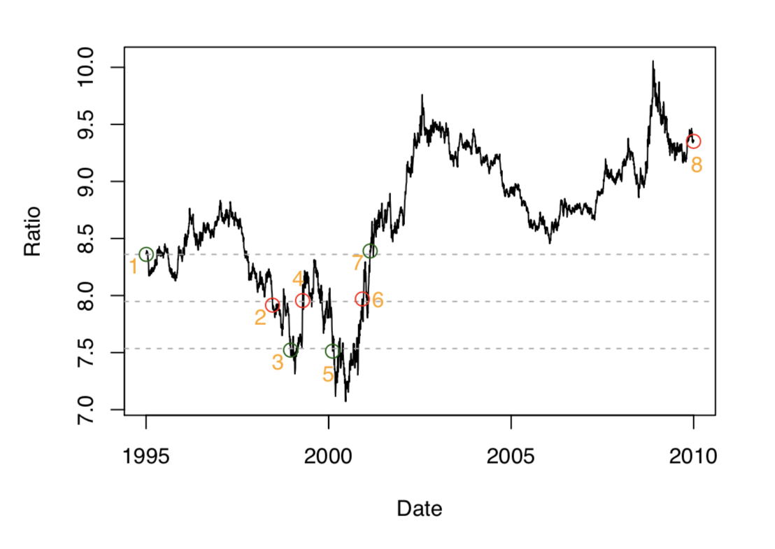
What can Clustering do?
• Financial Markets: In financial markets, the values of the stocks represent time-series which continually vary with time. The clustering of such time-series can provide numerous insights into the trends in the underlying data.
• Medical Data: Different kinds of medical data such as EEG readings are in the form of time series. The clustering of such time-series can provide an understanding of the common shapes in the data. These common shapes can be related to different kinds of diseases.
• Earth Science Applications: Numerous applications in earth science, such as temperature or pressure, correspond to series, which can be mined in order to determine the frequent trends in the data. These can provide an idea of the common climactic trends in the data.
*One of the first trading strategies: Pairs Trading. Developed by Morgan Stanley in the 1980s.

Slide 5
Theory

Slide 6
Time Series Clustering Steps
Measure the dissimilarity, similarity, characteristics of each pair of series.
Main criterion: correlation, Euclidean distance, Dynamic time warping(DTW) distance
2. Computing prototype, summarizes the characteristics of all series in a given cluster
Main methods: Mean and median, Partition around medoids
3. Group the series according to the metrics calculated in step 1 and/or 2.
Main methods: Hierarchical clustering, Partitional clustering

Slide 7
1) Distance Measure

Slide 8
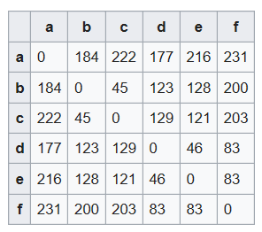
Global Distance Matrix
A square matrix containing the distances of each pair of the time series.
Distance can be the Euclidean distance or calculated in other ways (DTW).
Diagonal values are all zero
Off diagonal are usually positive
Usually symmetric
Used for Hierarchical clustering.

Slide 9
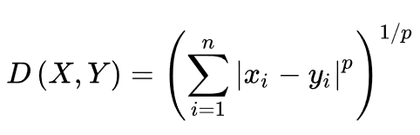

Minkowski distance
The Minkowski distance of order p between two series
Is defined as:
When p=2, it is the Euclidean distance.

Slide 10
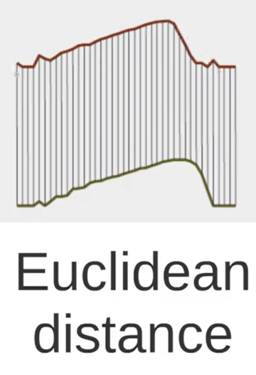
Euclidean distance
x1,x2,.................,xt,................xn
Pros :
Easy to understand and calculate X
Cons: Y
Require time series to be equal length.
Sensitive to noise, phase shift, scale difference
y1, y2,.................,yt,.............. yn

Slide 11
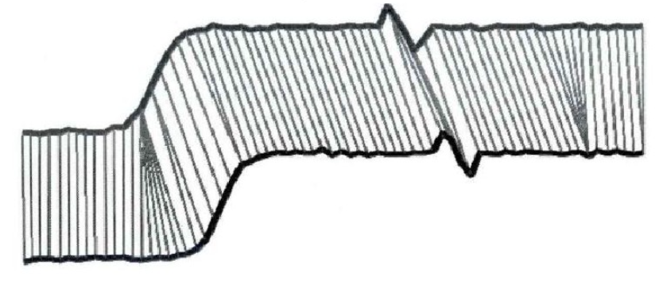
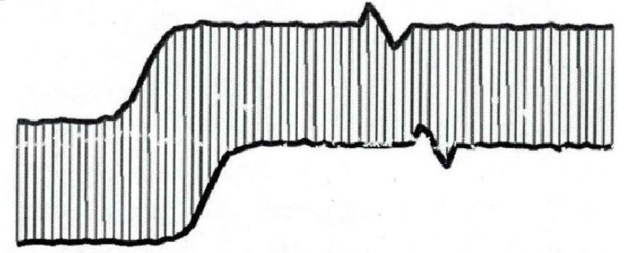
Dynamic Time Warping Distance
DTW is a dynamic algorithm that tries to ﬁnd the best warping path (alignment) between 2 time series points under certain constraints.
With the best warping path, the sum of the inter-points distance is the smallest.
Called the DTW distance between X and Y.
Euclidean DTW

Slide 12
DTW rules
Every xi must be matched with one or more yj.
x1 must be matched with y1. xn must be matched with yn.
Mapping index of X to Y must be non-decreasing.
If x3 is matched with y3, then x4 must be matched with either y3 or y4.
Because of rule 1, x4 can’t skip y4 and match with y5.
Euclidean DTW

Slide 13
Dynamic Time Warping Distance
Pros :
Can deal with different time series lengths.
Can deal with phase shift, noise, different scale.
Cons:
Time-consuming (O(nm)) and storage-consuming.
Euclidean DTW

Slide 14
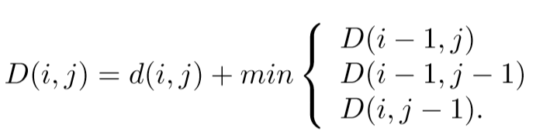
Algorithm to compute DTW Distance
How to find the best alignment is a recursion process.
d(i, j) : （ Local ）distance of xi and yj. E.g. d(i, j) = | xi - yj |
D(i, j) : DTW distance until xi and yj are paired.
Min { d(x1,y1)+...+ d(xi,yj) }
Single line connect xi and yj
Before connect xi yj.
Must connect one of 3:
(xi-1, yi)
(xi, yi-1)
(xi-1, yi-1)

Slide 15
Algorithm to compute DTW Distance
How to find the best alignment is a recursion process.
d(i, j) : （ Local ）distance of xi and yj. E.g. d(i, j) = | xi - yj |
D(i, j) : DTW distance until xi and yj are paired.
Min { d(x1,y1)+...+ d(xi,yj) }
Single line connect xi and yj
Before connect xi yj.
Must connect one of 3:
(xi-1, yi)
(xi, yi-1)
(xi-1, yi-1)
x2, x3, x4 x5
y2, y3, y4 y5
x2, x3, x4 x5
x2, x3, x4 x5
x2, x3, x4 x5
y2, y3, y4 y5
y2, y3, y4 y5
y2, y3, y4 y5

Slide 16
Algorithm to compute DTW Distance
How to find the best alignment is a recursion process.
d(i, j) : （ Local ）distance of xi and yj. E.g. d(i, j) = | xi - yj |
D(i, j) : DTW distance until xi and yj are paired.
Min { d(x1,y1)+...+ d(xi,yj) }
Single line connect xi and yj
Before connect xi yj.
Must connect one of 3:
(xi-1, yi)
(xi, yi-1)
(xi-1, yi-1)
x2, x3, x4 x5
y2, y3, y4 y5
x2, x3, x4 x5
x2, x3, x4 x5
x2, x3, x4 x5
y2, y3, y4 y5
y2, y3, y4 y5
y2, y3, y4 y5

Slide 17
Algorithm to compute DTW Distance
How to find the best alignment is a recursion process.
d(i, j) : （ Local ）distance of xi and yj. E.g. d(i, j) = | xi - yj |
D(i, j) : DTW distance until xi and yj are paired.
Min { d(x1,y1)+...+ d(xi,yj) }
Step 1: Local Cost Distance Matrix. Step 2: Wrapping Matrix
Single line connect xi and yj
Before connect xi yj.
Must connect one of 3:
(xi-1, yi)
(xi, yi-1)
(xi-1, yi-1)

Slide 18
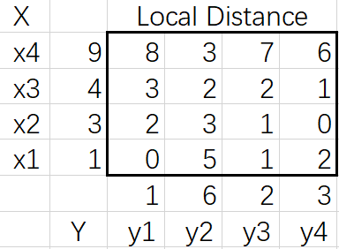
Local Distance Matrix
A matrix containing the local distance of each pair of time points of 2 time series.
Here d(i, j) = | xi - yj | is Manhattan distance
X: 1,3,4,9...
Y: 1,6,2,3...

Slide 19
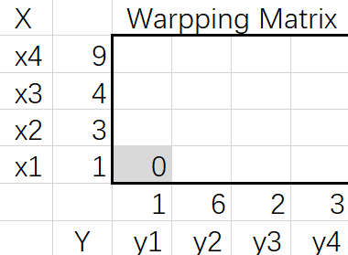
Wrapping Matrix
Each element in the wrapping matrix is D(i, j).
D(1,1)=0

Slide 20
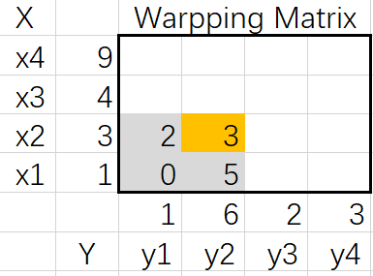
Wrapping Matrix
Each element in the wrapping matrix is D(i, j).
Example: D(2,2)=d(2,2)+min{ D(2,1), D(1,1), D(1,2) }= 3+min{2,0,5}=3

Slide 21
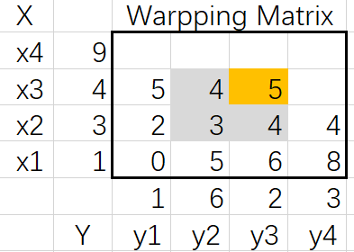
Wrapping Matrix
Each element in the wrapping matrix is D(i, j).
Example: D(3,3)=d(3,3)+min{ D(3,2), D(2,2), D(2,3) }= 2+min{4,3,4}=5

Slide 22
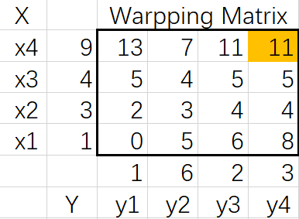
Wrapping Matrix
Each element in the wrapping matrix is D(i, j).
D(n,n)=DTW (X, Y)

Slide 23
2) Computing Prototype

Slide 24
How does the prototype work?
Prototyping could be a pre-processing step, whereby different samples from the same source can be summarized before clustering and then groups of similar characters could be sought, thought which the amount of data and execution time can be reduced
Another example is time-series classification based on nearest-neighbors, which can be optimized by considering only group-prototypes as neighbors instead of the union of all groups

Slide 25
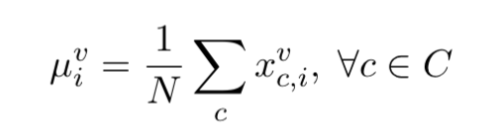

Mean and median
To calculate the mean, simply takes the average of each time-point i across all variables of the considered time-series
For a cluster C of size N, the time-series mean μ can be calculated as
where is the i-th element of the v-th variable from the c-th series that belongs to cluster C
Used very often in conjunction with the Euclidean distance

Slide 26
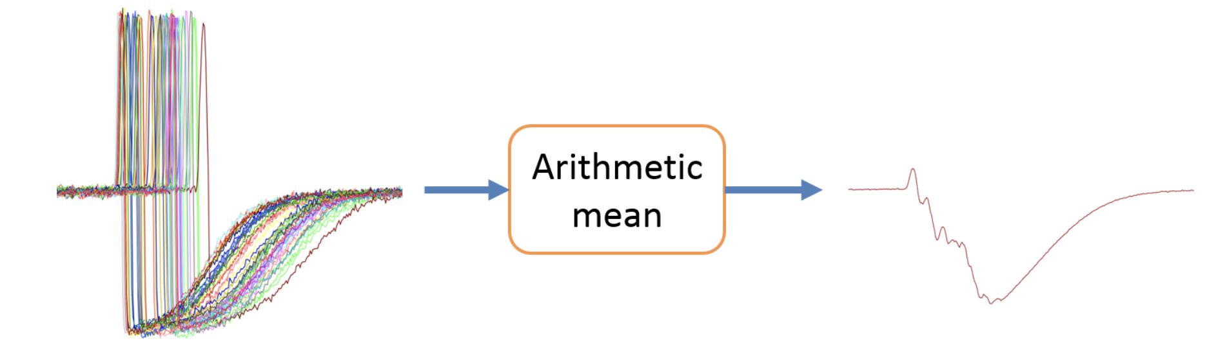
Mean and median
Pros :
Easy to calculate and understand
Cons:
Limited to series of equal length and equal amount of variables.
Structure of the prototype (which is also a time-series) is altered

Slide 27
Partition around medoids (PAM)
A medoid is a representative object from a cluster, whose average distance to all other objects in the same cluster is minimal
Summarized iterative procedure:
(i) Randomly chosen k series from the data as initial centroids
(ii) Calculate the distances between all series and the centroids, each series is
assigned to the cluster of its nearest centroid
(iii) For each created cluster, the distance between all member series is computed,
and the series with minimum sum of distances is chosen as the new centroid
(iv) Repeat (i)-(iii) until no series change clusters, or the maximum
number of allowed iterations has been exceeded.
Partitional clustering rely heavily on this prototype function

Slide 28
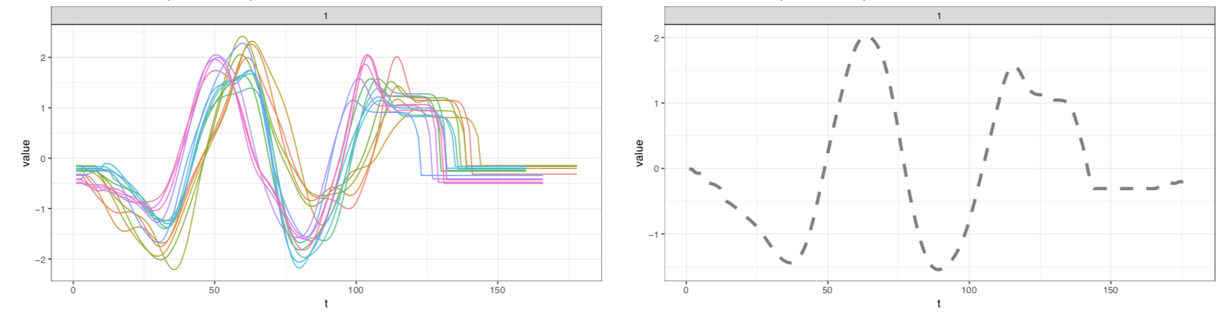
Partition around medoids (PAM)
Pros :
Since the medoid object is always an element of the original data, so the time-series structure is not altered.
The distance matrix can be reused on each iteration since the data don’t change
All series from a cluster Prototype of this cluster

Slide 29
3) Clustering Algorithms

Slide 30
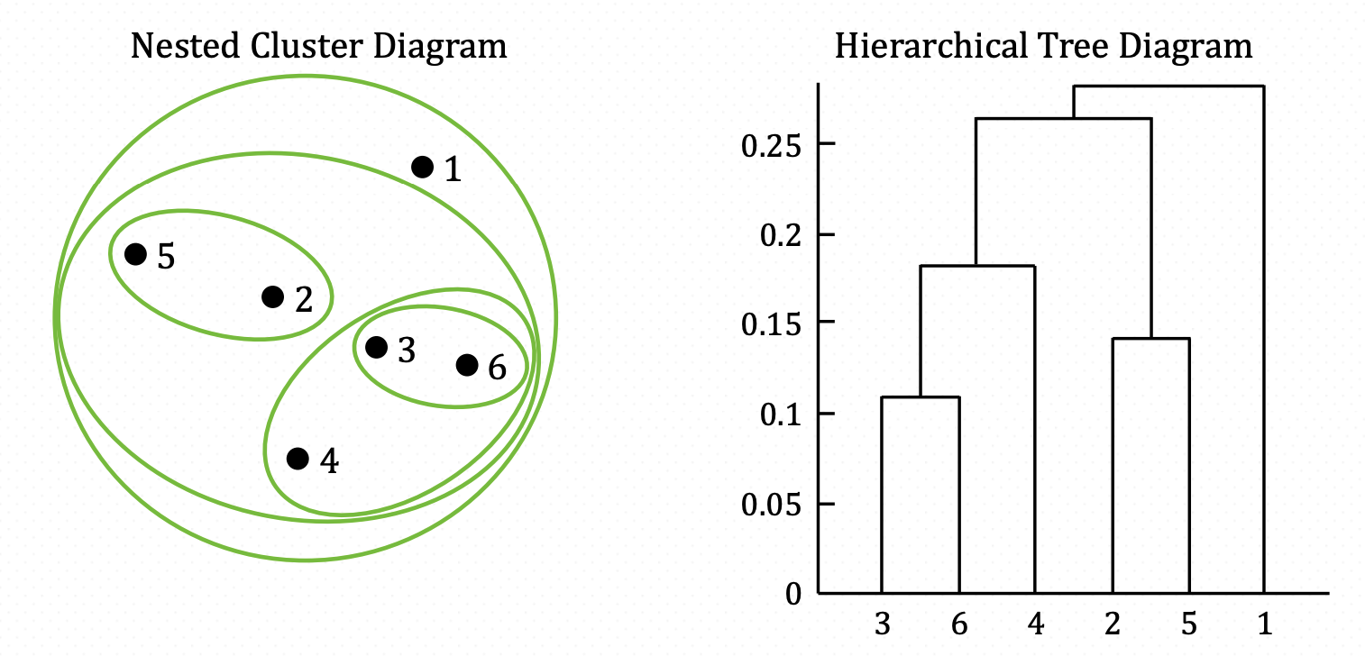
Hierarchical Clustering
Calculate the dissimilarity between groups (linkage)
Create a hierarchy of groups, then clusters are created by merging the clusters from the next lower level
Agglomerative or divisive
Dendrogram where the height of each node is proportional to the value of the intergroup dissimilarity between its two daughter nodes
Need a whole distance matrix, thus it’s good for small datasets
Nested Cluster Diagram
Dendrogram

Slide 31
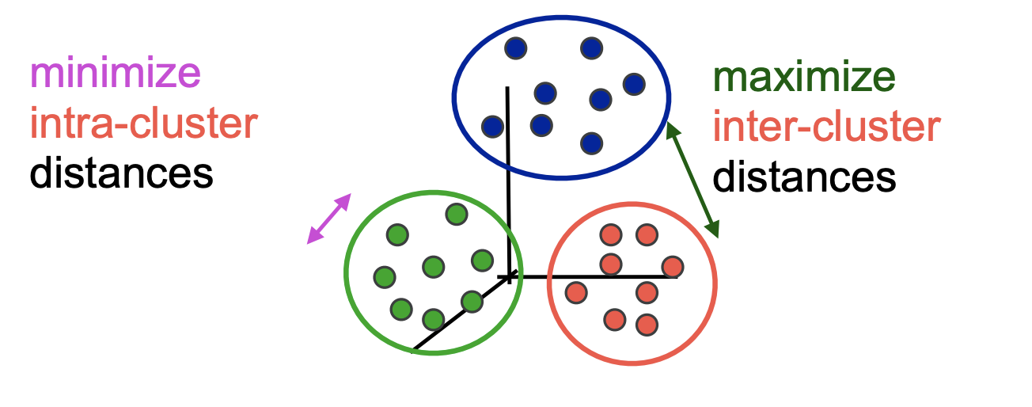
Partitional Clustering
Unlike Hierarchical Clustering which is a set of nested clusters organized in a tree, each object belongs in exactly one cluster
Depends heavily on prototyping functions
Lower complexity, can be applied to very large datasets

Slide 32
R demonstration

Slide 33
References
https://wenku.baidu.com/view/218a71c44bfe04a1b0717fd5360cba1aa8118cbe
https://wenku.baidu.com/view/54b191af760bf78a6529647d27284b73f24236bb.html?rec_flag=default&sxts=1554054948247
https://datawookie.netlify.com/blog/2017/04/clustering-time-series-data/
https://cran.r-project.org/web/packages/dtwclust/vignettes/dtwclust.pdf
https://en.wikipedia.org/wiki/Cluster_analysis
http://charuaggarwal.net/tsurvey.pdf
https://arxiv.org/pdf/1201.2969.pdf

